Slide 1
Jibebe Internship 2022
Progress report Week 2
Electric team
Name: Amos Wanene

Slide 2
Tasks completed last week
[#11] Mechanism for starting motor – The electric team and the mechanical team were able to come up with the solution to the jerk start problem encountered due to the transients of starting a motor by employing an electromagnetic clutch which would be responsible for coupling the motor to the load once it achieved steady state operation.
[#12] Simulation of motor operation – Simulation of the entire electric system; motor, battery and the projected load, was done in order to understand the various characteristics of the motor.

Slide 3
In the graphs below, the motor simulation is done with the following conditions:
The battery specifications are at 48V 50Ah Li-ion battery
All curves are plotted at maximum motor speed, i.e. 16km/hr.
The load of the tricycle is 150kg
The human power is 0W which indicates that no work is done by the passenger. All the work is done by the motor, i.e. it is fully electric.
Of importance in the following curves is to observe that as the grade value (gradient) is increased, the power required to maintain a speed of 16km/hr increases. In the first graph, with a grade of 0%, the motor power is 85W. In the second graph, with a grade of 2.5%, the motor power is 247W. In the third graph, with a grade of 5%, the motor power is 409W.

Slide 4
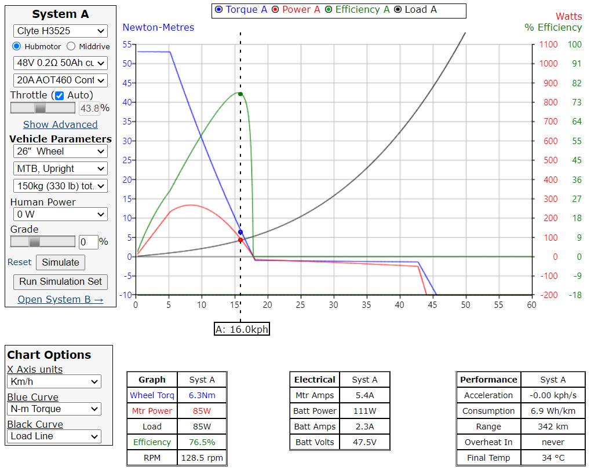



Slide 5
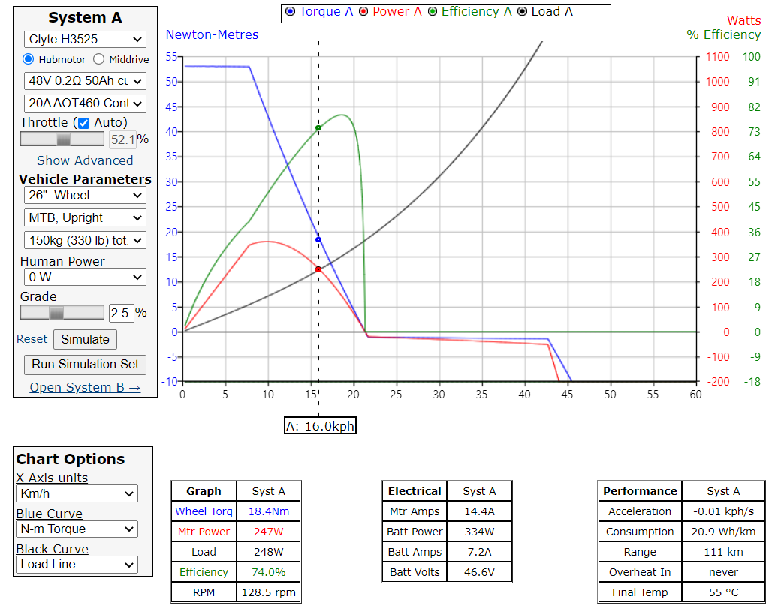



Slide 6
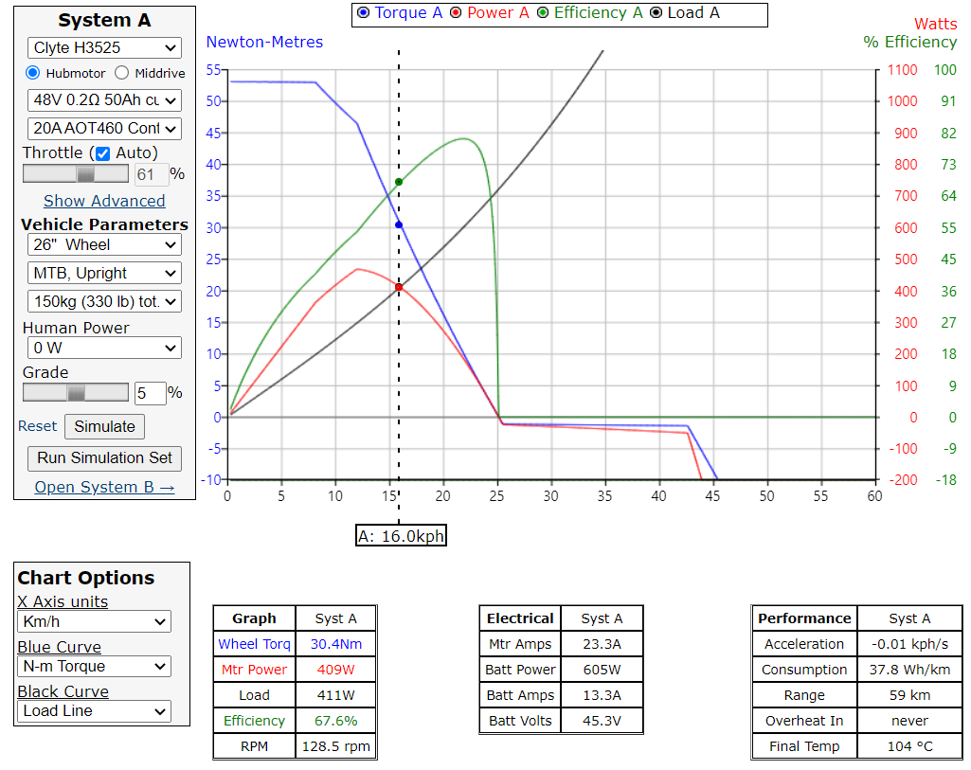



Slide 7
Tasks in this week
● [#14] Electric system experiments
● [#18] Analysis of perfomance curves

Slide 8
Timeline
Month | Intern Week | Tasks
Jan | Week 1 | Design of required Battery Pack for Motor and Speed Control
 | Week 2 | Acquisition and procurement if required components
 | Week 3 | Testing of components fir tricycle and design of tractor electric system
Feb | Week 4 | Integration of ordered parts to final tricycle implementation. Procurement of components for tractor
 | Week 5 | Solving miscellaneous issues arising from tricycle. Testing of tractor components
 | Week 6 | Testing of tractor components
 | Week 7 | Integration of final electric system of tractor
 | Week 8 | Integration with other subsystems

